Slide 1
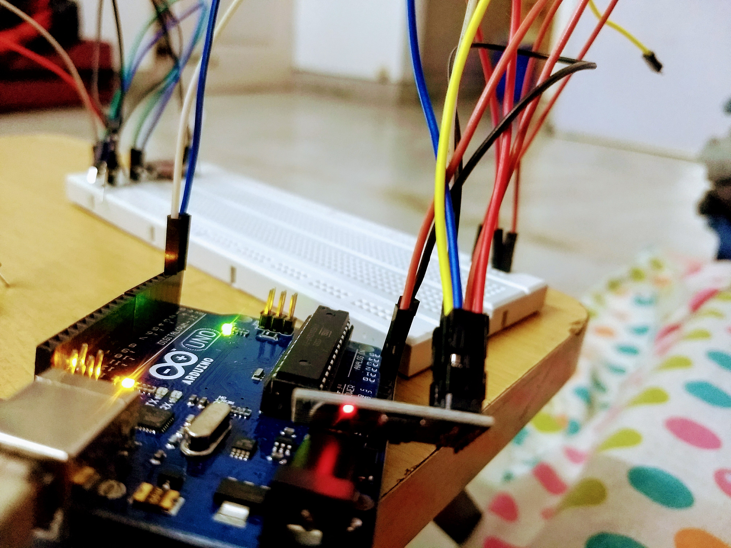
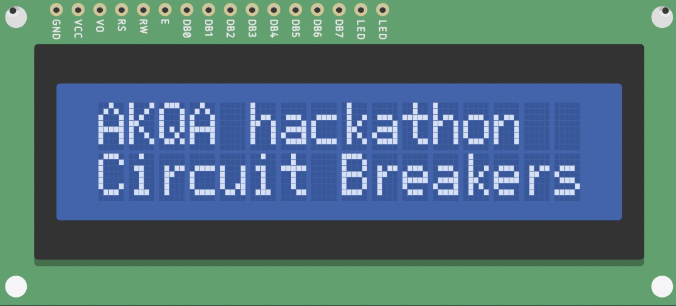
Meeting Room Alert System
Bhupendra Negi
Neetesh Keshari

Slide 2

The Problem ?

Slide 3
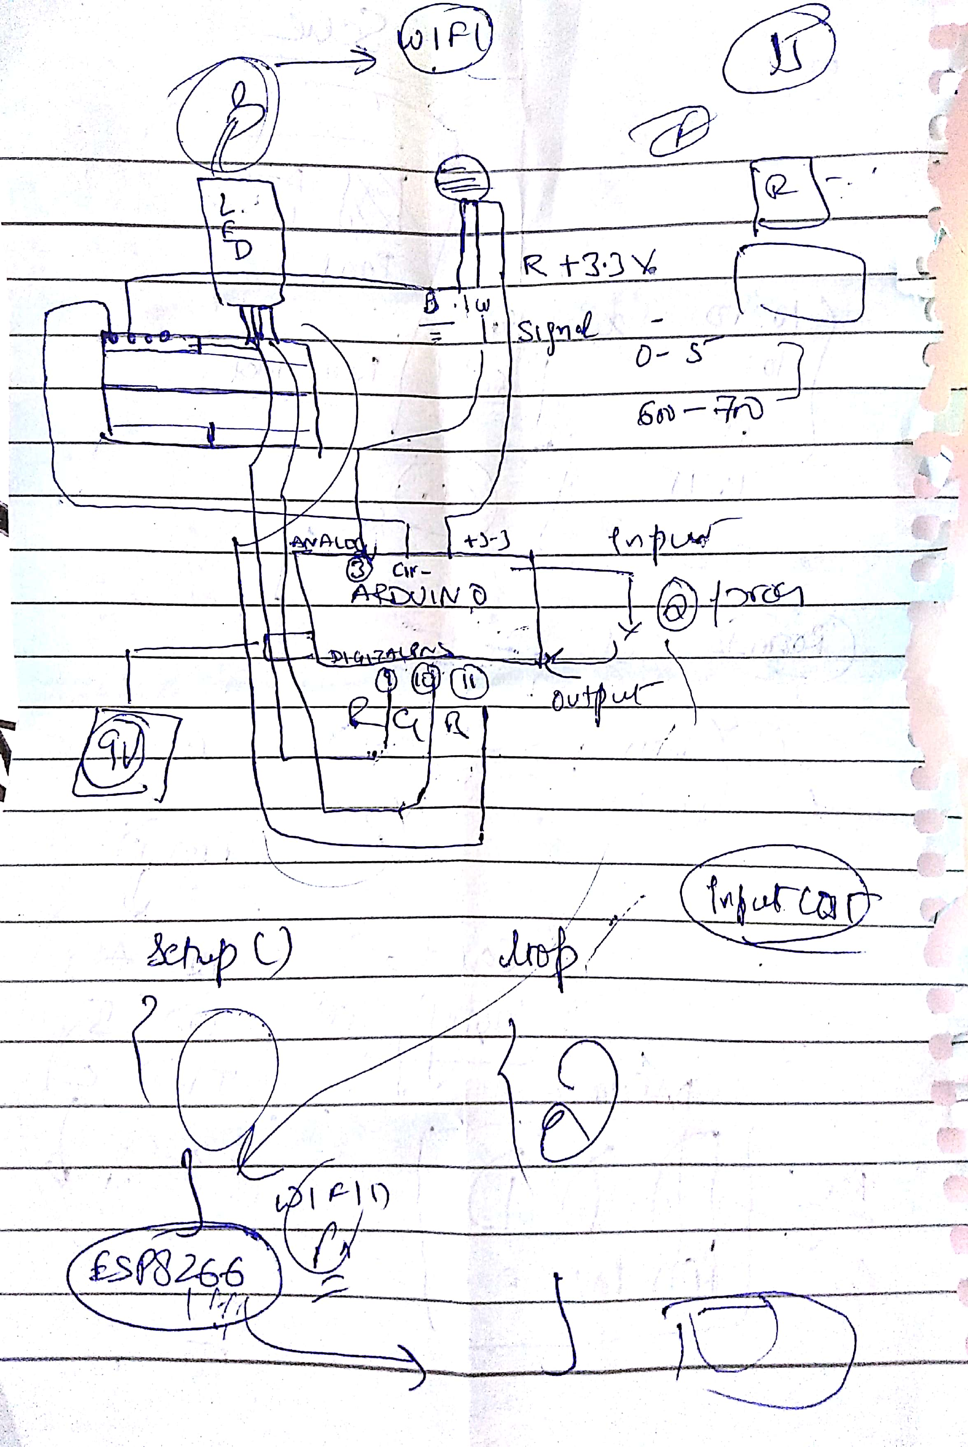
The Idea
Build IoT hardware and software that would know which meeting rooms were currently occupied and that made that information readily available – via both an indicator and a web front-end.

Slide 4
The Plan
Step 1: Upload simple sketch in Arduino / LED blink
Step 2: Use RGB LED to show rainbow of colors
Step 3: Detect motion with PIR Sensor
Step 4: Get light responds to motion
Step 5: Study ESP8266 guide
Step 6: Integrate wifi module with arduino and send sensor values to cloud
Step 7: Explore Microsoft GraphQL API’s.
Step 8: Consume ThinkSpeak Rest API and show information in dashboard
Step 9 : Send mail to user if room is blocked and meeting room is free
Step 10: Deploy application to cloud platform - Heroku

Slide 5
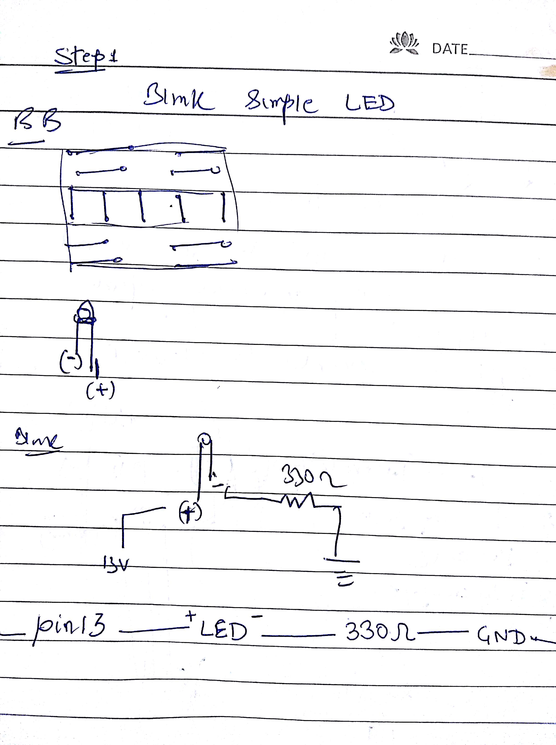
Step 1: Hello World Arduino
Getting started with Arduino , uploading simple sketch to Arduino Board.

Slide 6
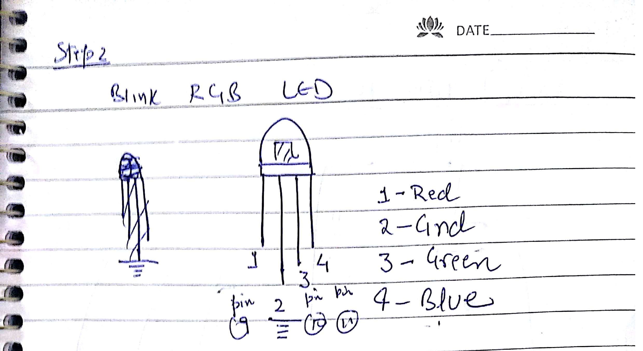
Step 2: Blink RGB LED
Connecting RGB Cathode with resistors on breadboard and powering up by Arduino to show rainbow of colors on glowing LED.

Slide 7
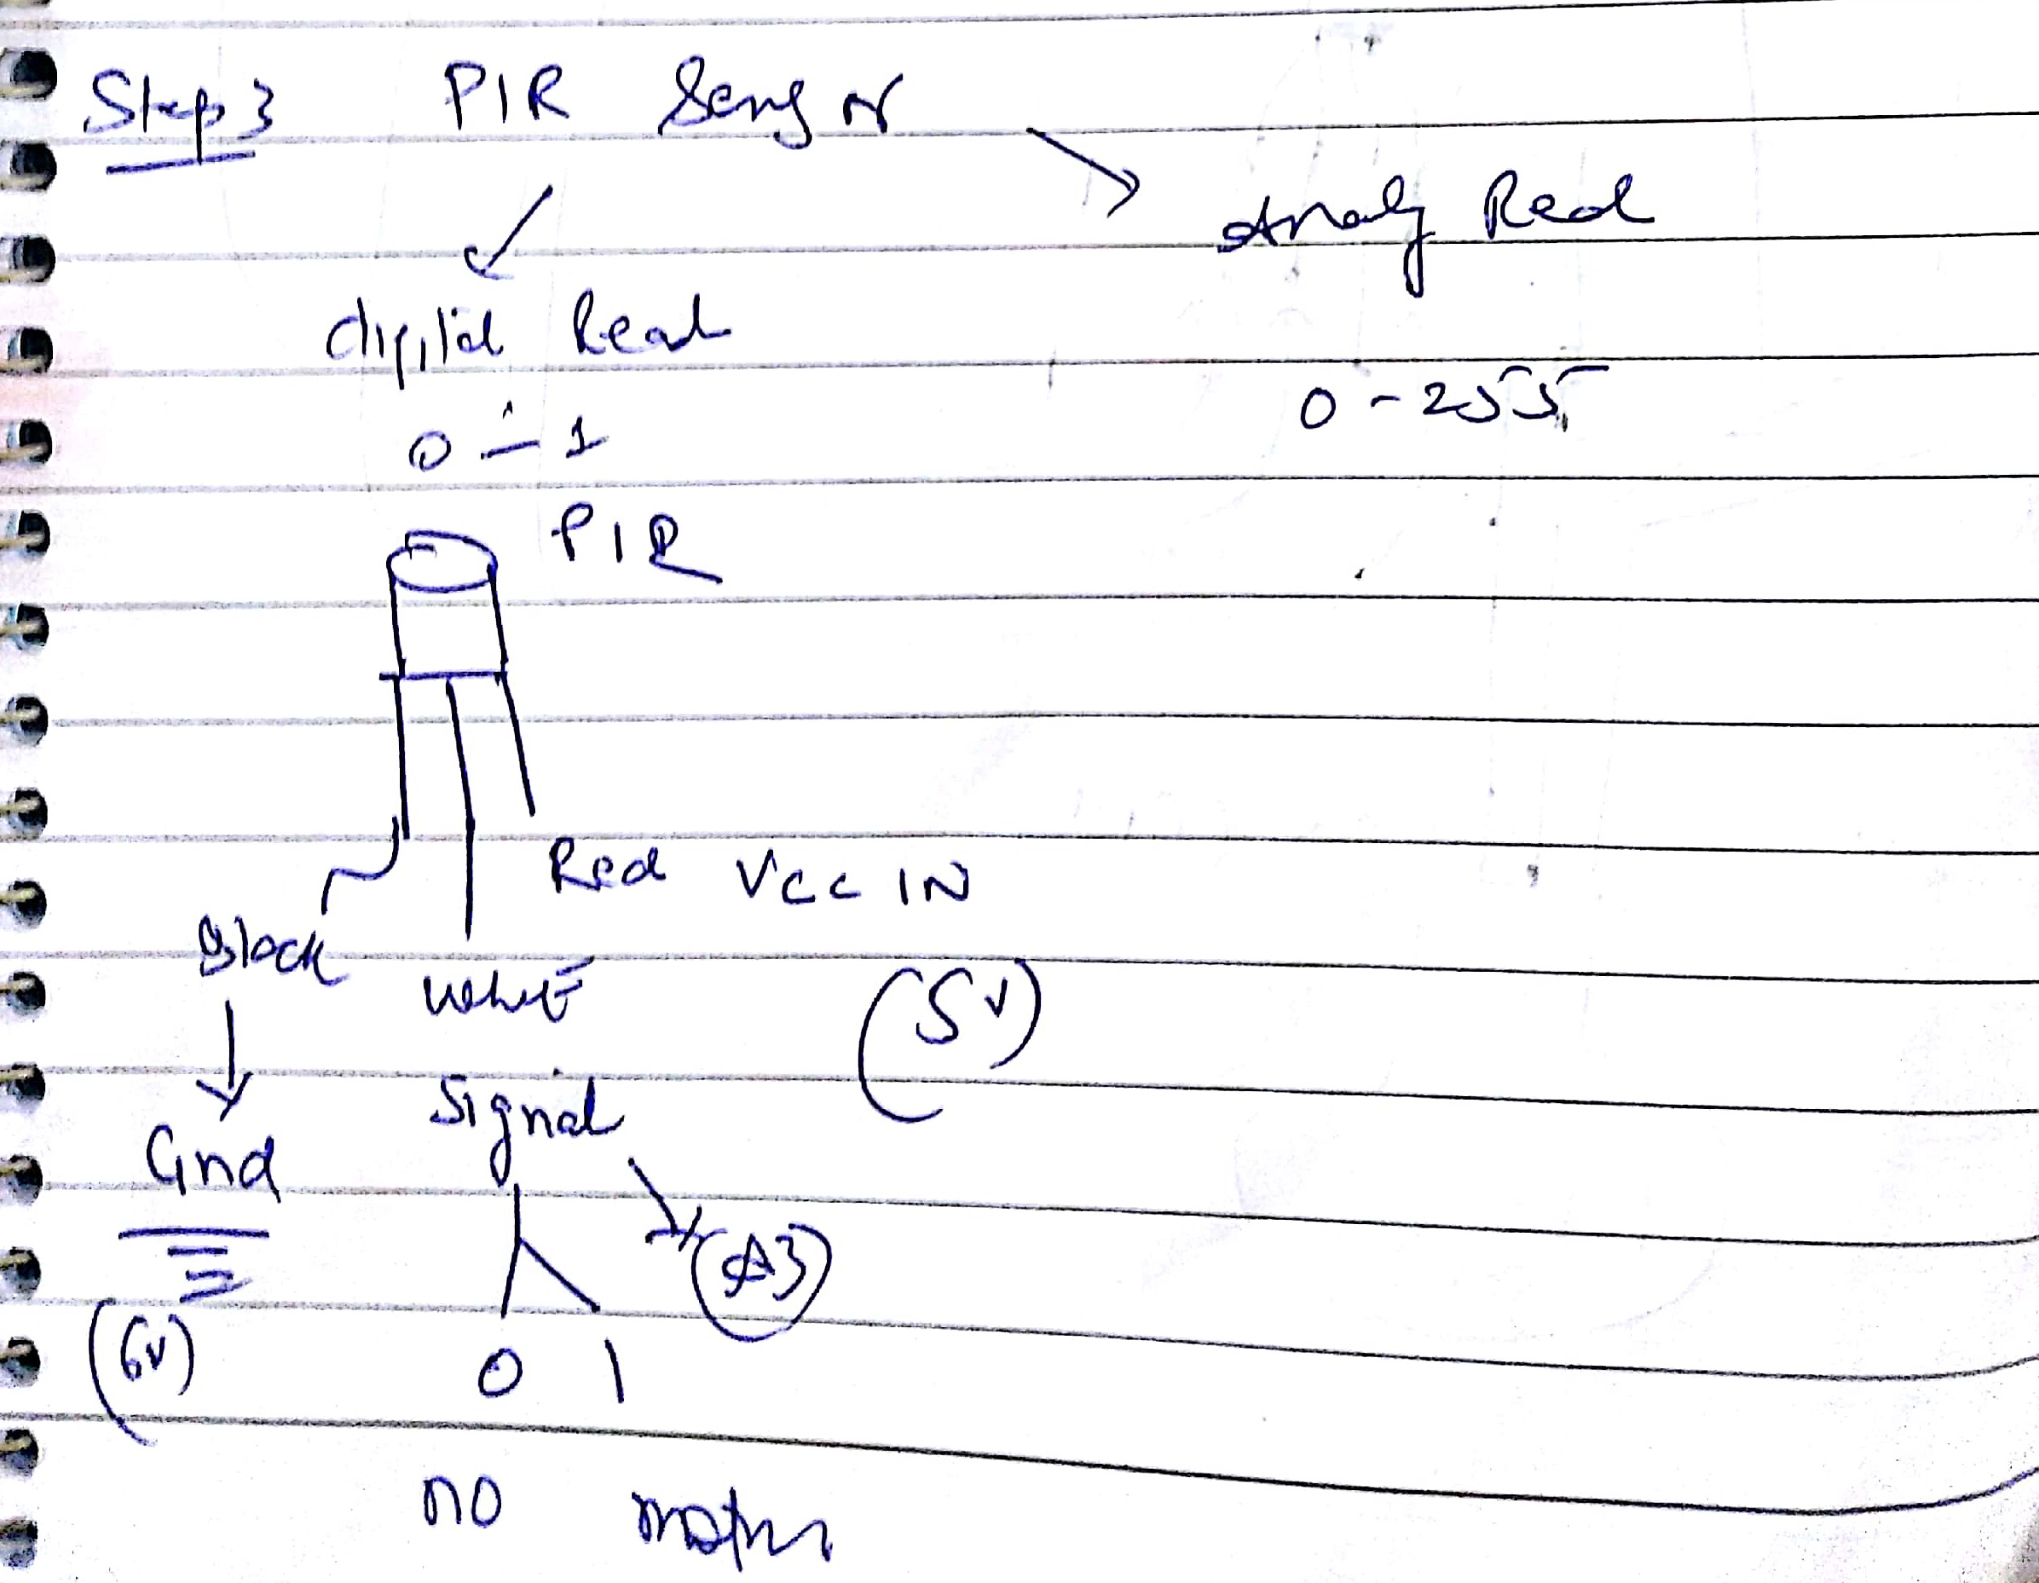
Step 3: Motion Detection
Learning basics of Passive Infrared Sensor (PIR) working

Slide 8
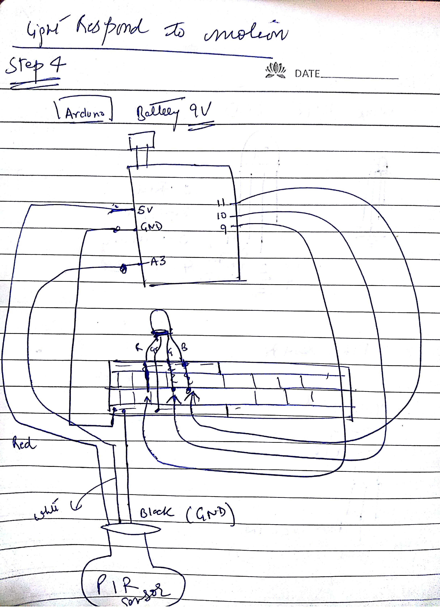
Step 4: Light responds to motion
Taking that analog value from the PIR and plugging it into the analog color display of our LED meant we had a light that changed color based on how close we came to it

Slide 9
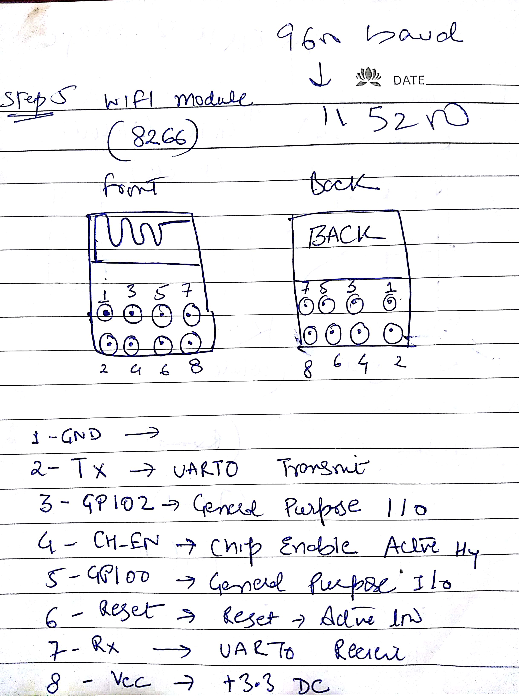
Step 5: Talking to internet
We used ESP8266 wifi module for wireless communication between Arduino and Cloud.Fired some AT commands to check wifi module connection.

Slide 10
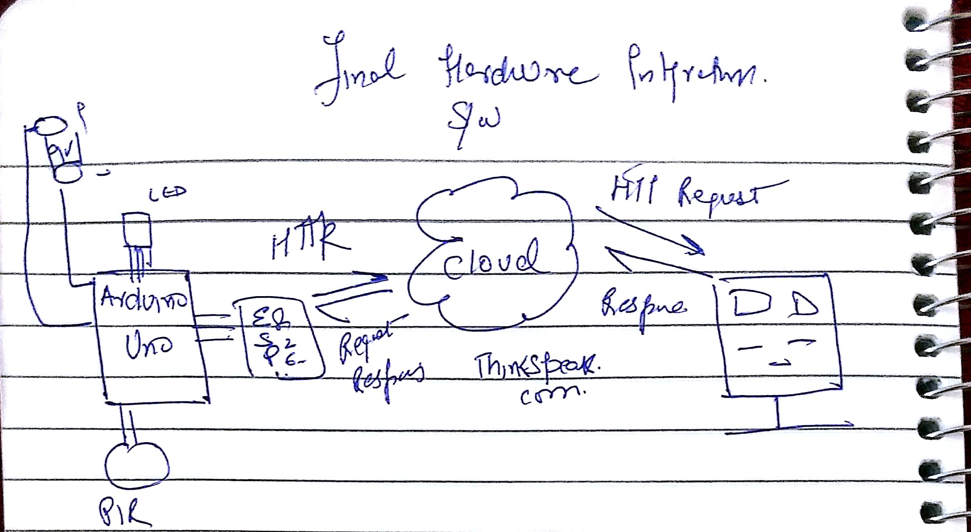
Step 6: Pushing Data to Cloud
We used ThinkSpeak.com to send our sensor values securely to cloud. It provides API’s to store and retrieve data from things using the HTTP protocol over the Internet.

Slide 11
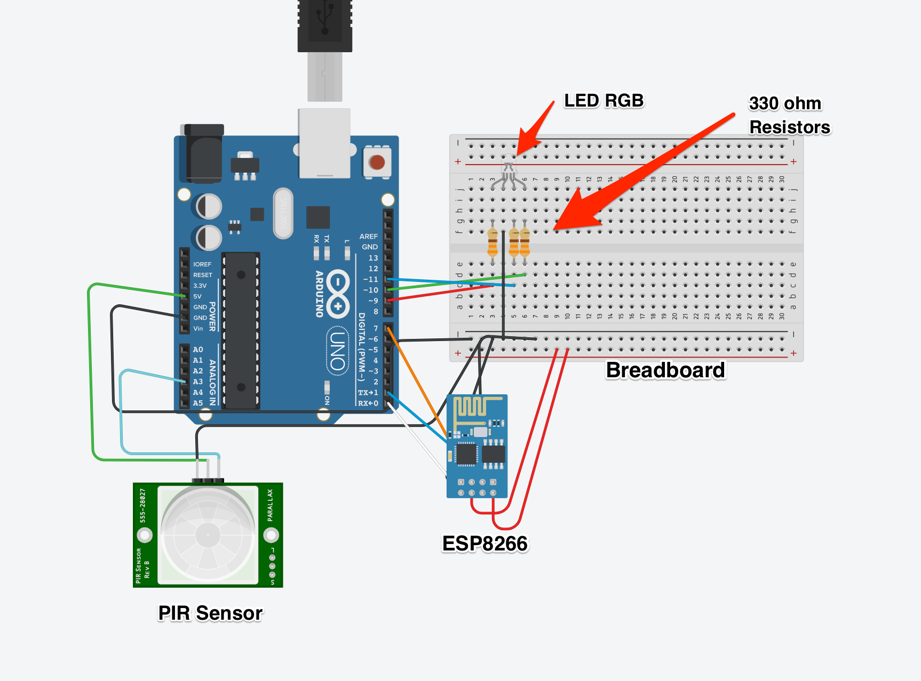
Circuit Diagram
Online Simulation : https://www.tinkercad.com/things/4ra0ynI9PYk-circuit-breaker/editel

Slide 12
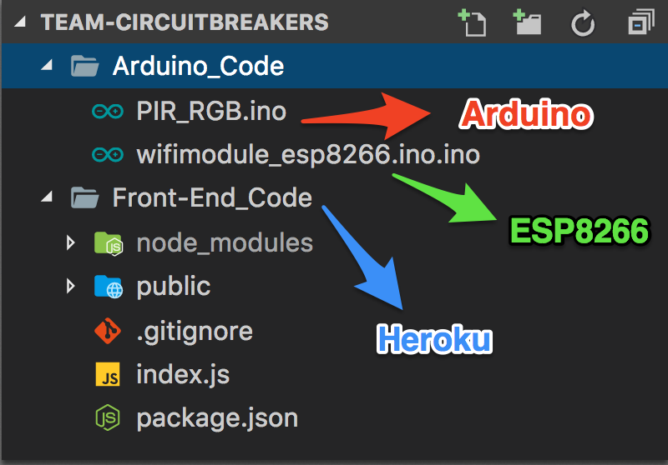
Show the code

Slide 13
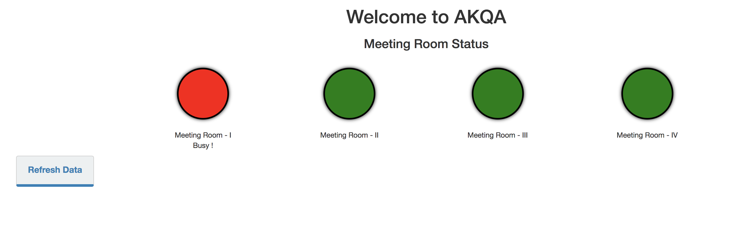
Front End Dashboard
App up & running : https://circuit-breakers.herokuapp.com/

Slide 14
Budget
Component | Price
Arduino Uno Board | 420 / $ 6
RGB LED | 99
Resistors | 24
PIR Sensor | 160 / $ 2.5
ESP8266 Module | 249
Jumper Wires ( 4 set ) | 209
9V Battery with strap | 200
Breadboard | 140
₹ 1501 / ~ $ 23
For installing setup in new room : $ 3
Raspberry PI board: $ 46

Slide 15
Scalability
Hardware required to another room as smart conference room :
Components | Price
ESP8266 | 249
PIR Sensor | 160
Battery + Strap | 100
509 /
ThinkSpeak Public API with Sensor Data : http://api.thingspeak.com/channels/403274/fields/1.json?results=2
Deployed front end code on cloud via Heroku:
https://circuit-breakers.herokuapp.com/
https://dashboard.heroku.com/apps/circuit-breakers

Slide 16


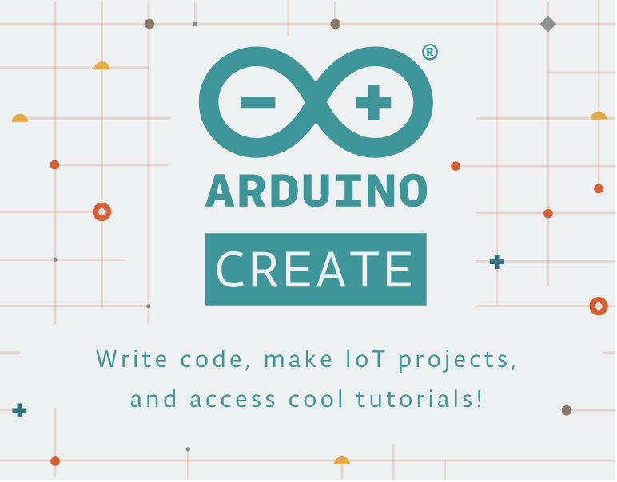



Dev Environment
https://trello.com/b/WAvYVvtE/hackathon

Slide 17
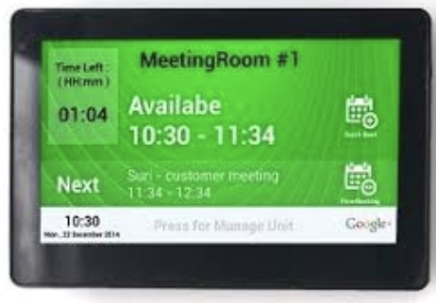
So , What Next ?
Integrate with Microsoft Graph APIs
Installing Sensors in All meeting rooms
Installing Display at the entrance of each meeting room which will show upcoming meeting scheduled

Slide 18
References
http://rancidbacon.com/files/kiwicon8/ESP8266_WiFi_Module_Quick_Start_Guide_v_1.0.4.pdf
https://www.arduino.cc/en/Tutorial/HomePage
http://www.espressif.com/sites/default/files/documentation/4a-esp8266_at_instruction_set_en.pdf
http://community.thingspeak.com/tutorials/

Slide 19

Q / A

